Slide 1
BIRD Draft.
New AMI Reserved Parameter for
Sampling Position in the AMI_Init flow.
Hansel Desmond Dsilva
Acknowledgement: Walter Katz, Mike Mirmak, Todd Bermensolo, Adam Gregory, Mike Steinberger, Ambrish Varma, Ken Willis, Fangyi Rao, Vladimir Dmitriev-Zdorov and Arpad Muranyi

Slide 2
Table of contents
Call to Action
Problem Statement
Proposal
Demo
Generation of an pulse and step response from an impulse response when in the time domain
Feedback

Slide 3
1. Call to Action
DesignCon 2020 IBIS Summit, “Gap in IBIS for sampling with statistical mode AMI models” by Todd Bermensolo, Hansel Dsilva and Mike Mirmak
Statistical-mode-based simulations are widely used.
IBIS specification has a gap if we want IBIS-AMI to behave accurately to silicon design consistently across EDA tools. We should consider adding sampling point information to AMI_Init.
The Larger Question: Who controls the presentation & calculation of the eye?
Should not model-makers be able to represent silicon behavior completely, including sampling, in both statistical and time-domain modes?

Slide 4
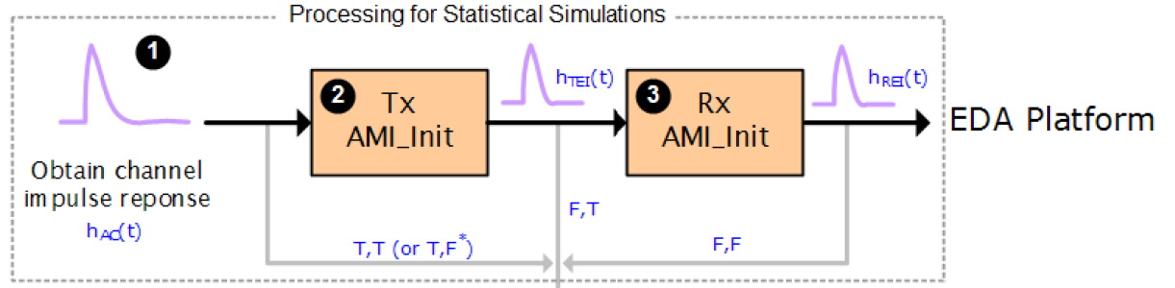
2. Problem Statement.
In the AMI_Init flow as it’s currently defined (IBIS v7.0), the IBIS-AMI model delivers to the EDA tool an impulse response, but no information about any clock that might be recovered from the signal.
long AMI_Init (double *impulse_matrix,
long number_of_rows,
long aggressors,
double sample_interval,
double bit_time,
char *AMI_parameters_in,
char **AMI_parameters_out,
void **AMI_memory_handle,
char **msg)
https://www.keysight.com/us/en/assets/7018-03143/application-notes/5990-9111.pdf

Slide 5
3. Proposal
Parameter: Rx_Decision_Time
Required: No, and illegal before AMI_Version 7.1
Direction: Rx
Descriptors:
Usage: Out
Type: Float
Format: Value
Default: Value
Description: <numeric_literal>
Definition: The AMI_Init model outputs a time value in seconds, which is the receiver decision point of the symbol that the threshold
crossing started with respect to time zero of the impulse response returned by the model. In the AMI_Init flow, this decision point
represents the mean or median sampling point.
Usage Rules: The EDA tool when using the AMI_Init flow uses this information in determining the cursor, precursor and post cursor locations.
If omitted, the EDA tool will have to determine the receiver decision point on its own.
Example:
(Rx_Decision_Time (Usage Out) (Value 0.0) (Type Float)
(Description "The time value in seconds, which is the receiver decision point of the symbol that the threshold crossing started
with respect to time zero of the impulse response.")
)

Slide 6
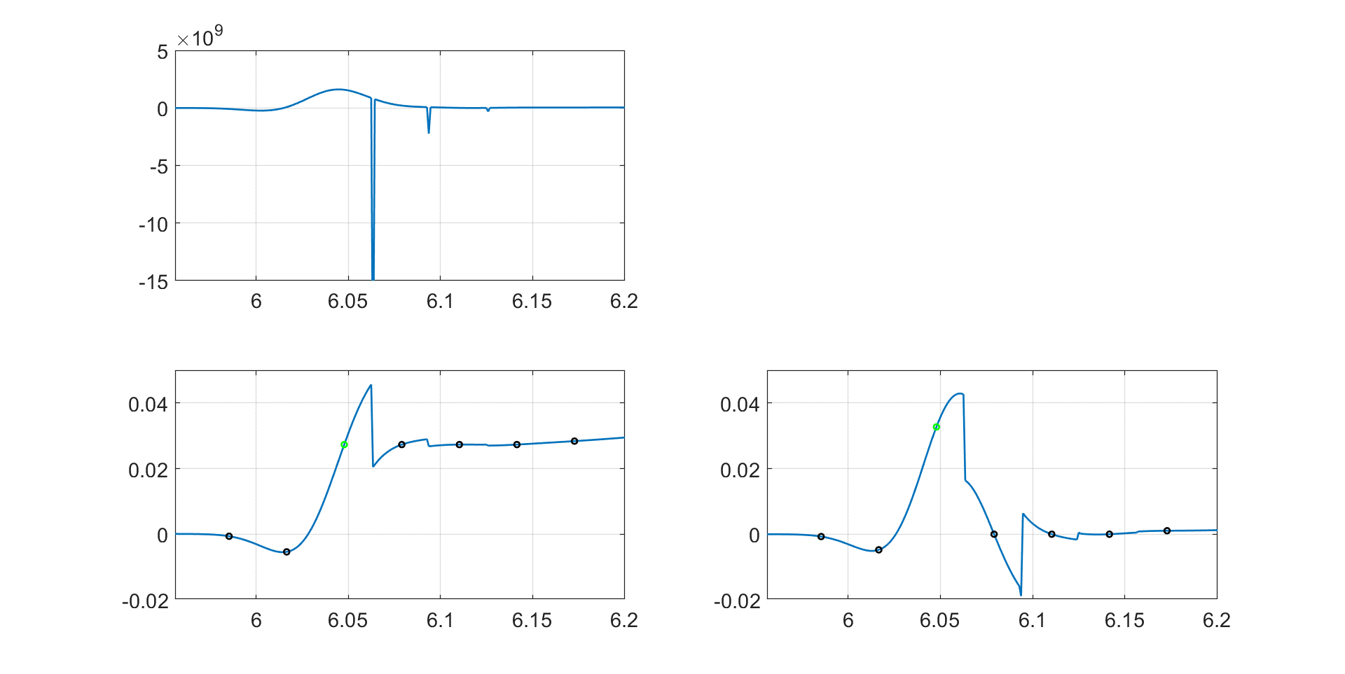
3. Demo
long AMI_Init (double *impulse_matrix,
long number_of_rows,
long aggressors,
double sample_interval,
double bit_time,
char *AMI_parameters_in,
char **AMI_parameters_out,
void **AMI_memory_handle,
char **msg)
(output
(Rx_Decision_Time (Usage Out) (Value 0.0) (Type Float)
(Description “The time value in seconds, which is the
receiver decision point of the symbol that the threshold
crossing started with respect to time zero of the
impulse response."))
)
RX IBIS-AMI
CTLE, FFE and DFE
&
EDA tool
2.
Step response
or
pulse response
1.
impulse_matrix= [18238x1] double
number_of_rows= 1
agressors= 0
sample_interval= 0.9765625e-12
bit_time= 31.125e-12
AMI_parameter_in= 0x0 char
AMI_parameter_out= 39x1 char
msg= 0x0 char
Impulse Response (ir) [1/s]
3.
Time [nsec]
(output (Rx_Decision_Time 6.0491e-09))
Step Response (sr) [V]
Pulse Response (pr) [V]
Rx_Decision_Time
Rx_Decision_Time
= 6.0491e-09
= 6.0491e-09
Time [nsec]
Time [nsec]

Slide 7
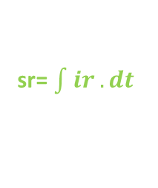

4. Generation of an pulse and step response from an impulse response when in the time domain
sr= $\int{ir}.dt$
pr= pulse_stimulus ir
pr= filter(pulse_stimulus, 1, ir)
Impulse Response (ir). [1/s]
x
pr=sr- sr$|_{delayed by 1 UI}$
Time [nsec]
Assume, rise and fall time are equal.
Rx_Decision_Time
= 6.0491e-09
The impulse response does not hold any information pertaining to a unit interval
Pulse Response (pr). [V]
Time [nsec]
Step Response (sr). [V]
Rx_Decision_Time
= 6.0491e-09
Most statistical analysis algorithms combine the unit interval with the impulse response to obtain either a step response or a pulse response, and complete the analysis using one of those responses.
Time [nsec]
*where, the pulse stimulus that has value of
1 for 0 <= t < bit period
and
0 at t >= bit period.

Slide 8
5. Feedback
Question #4,
Question #1,
Suggestion: “which is the delay between the logic transition at the decision point of the receiver for the input symbol and…”; there’s a question here about whether logic transition is correct, as it may include some additional internal receiver delay ?
A different name for the parameter?
Parameter: Rx_Decision_Time
Required: No, and illegal before AMI_Version 7.1
Direction: Rx
Descriptors:
Usage: Out
Type: Float
Format: Value
Default: Value
Description: <numeric_literal>
Definition: The AMI_Init model outputs a time value in seconds, which is the receiver decision point of the symbol that the threshold
crossing started with respect to time zero of the impulse response returned by the model. In the AMI_Init flow, this decision point
represents the mean or median sampling point.
Usage Rules: The EDA tool when using the AMI_Init flow uses this information in determining the cursor, precursor and post cursor locations.
Rx_Decision_Time takes precedence over Rx_Clock_Recovery_Mean for statistical (Init) processing.
If omitted, the EDA tool will have to determine the receiver decision point on its own.
Example:
(Rx_Decision_Time (Usage Out) (Value 0.0) (Type Float)
(Description "The time value in seconds, which is the receiver decision point of the symbol that the threshold crossing started
with respect to time zero of the impulse response.")
)
Question #2,
May we support fractional value of UI?
The RX IBIS-AMI model returns a modified impulse response.
“Ball in the IBIS-AMI model developers court”.
Question #3,
Do we call out a mean or median sampling point?
Question #5,
Editorial change: “receiver delay point transition delay”?

Slide 9
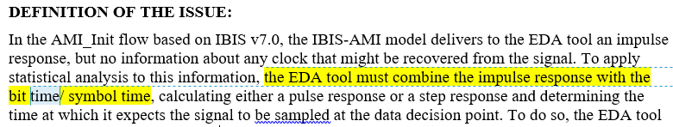
Question.
What is the symbol time/ bit time used for PAM4?
Closed!
04/28/2020
Mike M.: Is symbol time used here so that PAM4 is supportd?
Hansel: I believe the EDA tool would set the appropriate bit time/ symbol time when detected is PAM4.
Good question!
long AMI_Init (double *impulse_matrix,
long number_of_rows,
long aggressors,
double sample_interval,
double bit_time,
char *AMI_parameters_in,
char **AMI_parameters_out,
void **AMI_memory_handle,
char **msg)
For 56 Gbps NRZ and 32 samples per UI,
bit_time= 1/(56e9)
sample_interval= (1/(56e9))/32
Sample_interval (aka time_step)
bit_time (aka symbol time
; do not call it unit_interval)
For 56 Gbps PAM4 and 32 samples per UI,
bit_time= 1/(56e9/2)
sample_interval= (1/(56e9/2))/32
Is this being followed by EDA tools and model developers?
Answer. Yes.

Slide 10
Question #1,
A different name for the parameter?
Parameter: Rx_Decision_Time
Required: No, and illegal before AMI_Version 7.1
Direction: Rx
Descriptors:
Usage: Out
Type: Float
Format: Value
Default: Value
Description: <numeric_literal>
Definition: The AMI_Init model outputs a time value in seconds, which is the receiver decision point of the symbol that the threshold
crossing started with respect to time zero of the impulse response returned by the model. In the AMI_Init flow, this decision point
represents the mean or median sampling point.
Usage Rules: The EDA tool when using the AMI_Init flow uses this information in determining the cursor, precursor and post cursor locations.
Rx_Decision_Time takes precedence over Rx_Clock_Recovery_Mean for statistical (Init) processing.
If omitted, the EDA tool will have to determine the receiver decision point on its own.
Example:
(Rx_Decision_Time (Usage Out) (Value 0.0) (Type Float)
(Description "The time value in seconds, which is the receiver decision point of the symbol that the threshold crossing started
with respect to time zero of the impulse response.")
)
Answer. No change in name.
Closed!
05/06/2020

Slide 11
Closed!
04/28/2020
Parameter: Rx_Decision_Time
Required: No, and illegal before AMI_Version 7.1
Direction: Rx
Descriptors:
Usage: Out
Type: Float
Format: Value
Default: Value
Description: <numeric_literal>
Definition: The AMI_Init model outputs a time value in seconds, which is the receiver decision point of the symbol that the threshold
crossing started with respect to time zero of the impulse response returned by the model. In the AMI_Init flow, this decision point
represents the mean or median sampling point.
Usage Rules: The EDA tool when using the AMI_Init flow uses this information in determining the cursor, precursor and post cursor locations.
Rx_Decision_Time takes precedence over Rx_Clock_Recovery_Mean for statistical (Init) processing.
If omitted, the EDA tool will have to determine the receiver decision point on its own.
Example:
(Rx_Decision_Time (Usage Out) (Value 0.0) (Type Float)
(Description "The time value in seconds, which is the receiver decision point of the symbol that the threshold crossing started
with respect to time zero of the impulse response.")
)
Question #2,
May we support fractional value of UI?
Answer. Yes, mention Float, UI.

Slide 12
Closed!
04/28/2020
Parameter: Rx_Decision_Time
Required: No, and illegal before AMI_Version 7.1
Direction: Rx
Descriptors:
Usage: Out
Type: Float
Format: Value
Default: Value
Description: <numeric_literal>
Definition: The AMI_Init model outputs a time value in seconds, which is the receiver decision point of the symbol that the threshold
crossing started with respect to time zero of the impulse response returned by the model. In the AMI_Init flow, this decision point
represents the mean or median ideal sampling point.
Usage Rules: The EDA tool when using the AMI_Init flow uses this information in determining the cursor, precursor and post cursor locations.
Rx_Decision_Time takes precedence over Rx_Clock_Recovery_Mean for statistical (Init) processing.
If omitted, the EDA tool will have to determine the receiver decision point on its own.
Example:
(Rx_Decision_Time (Usage Out) (Value 0.0) (Type Float)
(Description "The time value in seconds, which is the receiver decision point of the symbol that the threshold crossing started
with respect to time zero of the impulse response.")
)
Question #3,
Answer. Neither, mention instead “ideal sampling point” which mentions that jitter would be added over this sampling point.
Do we call out a mean or median sampling point?

Slide 13
Question #4,
Closed!
05/06/2020
Suggestion: “which is the delay between the logic transition at the decision point of the receiver for the input symbol and…”; there’s a question here about whether logic transition is correct, as it may include some additional internal receiver delay ?
Parameter: Rx_Decision_Time
Required: No, and illegal before AMI_Version 7.1
Direction: Rx
Descriptors:
Usage: Out
Type: Float
Format: Value
Default: Value
Description: <numeric_literal>
Definition: The AMI_Init model outputs a time value in seconds, which is the receiver decision point time of the symbol that the threshold
crossing started with respect to time zero of the impulse response returned by the model. In the AMI_Init flow, this decision point time
represents the mean or median sampling point ideal sampling time.
Usage Rules: The EDA tool when using the AMI_Init flow uses this information in determining the cursor, precursor and post cursor locations.
Rx_Decision_Time takes precedence over Rx_Clock_Recovery_Mean for statistical (Init) processing.
If omitted, the EDA tool will have to determine the receiver decision point time on its own.
Example:
(Rx_Decision_Time (Usage Out) (Value 0.0) (Type Float)
(Description "The time value in seconds, which is the receiver decision point of the symbol that the threshold crossing started
with respect to time zero of the impulse response.")
)
The RX IBIS-AMI model returns a modified impulse response.
“Ball in the IBIS-AMI model developers court”.
Answer to #4 and #5. Replace “word” to “time”.
Question #5,
Editorial change: “receiver delay point transition delay”?

Slide 14
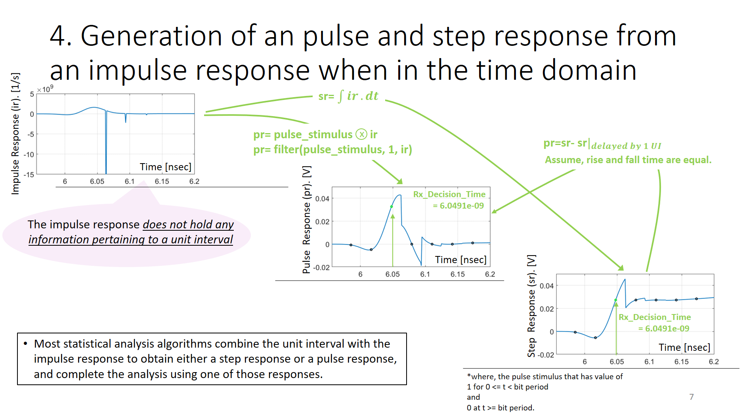
Question #6.
Ambrish: Do we want to provide guidance on generation of a pulse and step response from an impulse response through the IBIS specification?
Closed!
05/06/2020
Answer. No.
Slide 7

Slide 15
Question #7.
Arpad: Do we want to give guidance to EDA tools for an ideal CDR and PD through the IBIS specification when no clock_ticks is returned by AMI_GetWave and Rx_Decision_Time is returned by AMI_Init?
Would it be beneficial to have the model always return clock_ticks and Rx_Decision_time when in the AMI_GetWave and AMI_Init flow respectively as a requirement for quality models?
Closed!
05/06/2020
Answer. No. May revisit this at a later time.

Slide 16
BIRD Draft sent out to IBIS-ATM for review.
Parameter: Rx_Decision_Time
Required: No, and illegal before AMI_Version 7.1
Direction: Rx
Descriptors:
Usage: Out
Type: Float
Format: Value
Default: <numeric_literal>
Description: <string>
Definition: The AMI_Init model outputs a time value in seconds, which is the receiver decision time of the symbol that the threshold
crossing started with respect to time zero of the impulse response returned by the model. In the AMI_Init flow, this decision time
represents the ideal sampling time.
Usage Rules: The EDA tool when using the AMI_Init flow uses this information in determining the cursor, precursor and post cursor locations.
Rx_Decision_Time takes precedence over Rx_Clock_Recovery_Mean for statistical (Init) processing.
If omitted, the EDA tool will have to determine the receiver decision time on its own.
Example:
(Rx_Decision_Time (Usage Out) (Value 0.0) (Type Float)
(Description "The time value in seconds, which is the receiver decision point of the symbol that the threshold crossing started
with respect to time zero of the impulse response returned by the model.")
)

Slide 17

Thank You

Slide 18
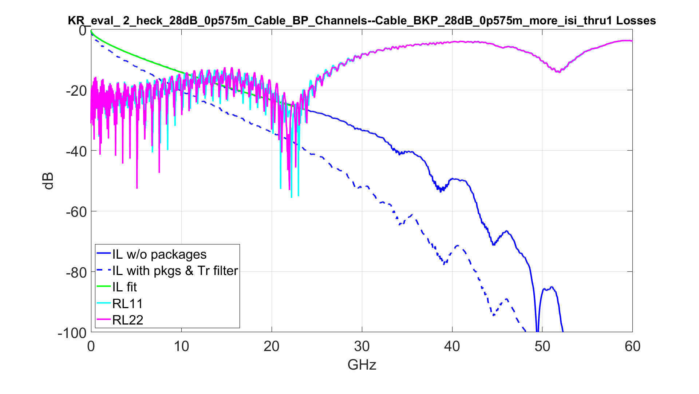
3. Channel Response
Channel taken from IEEE 802.3 public area.
-28.53 dB @ 16 GHz
32Gbps NRZ, 1 pre and 1 post TXLE, CTLE and 3 tap DFE

Slide 19
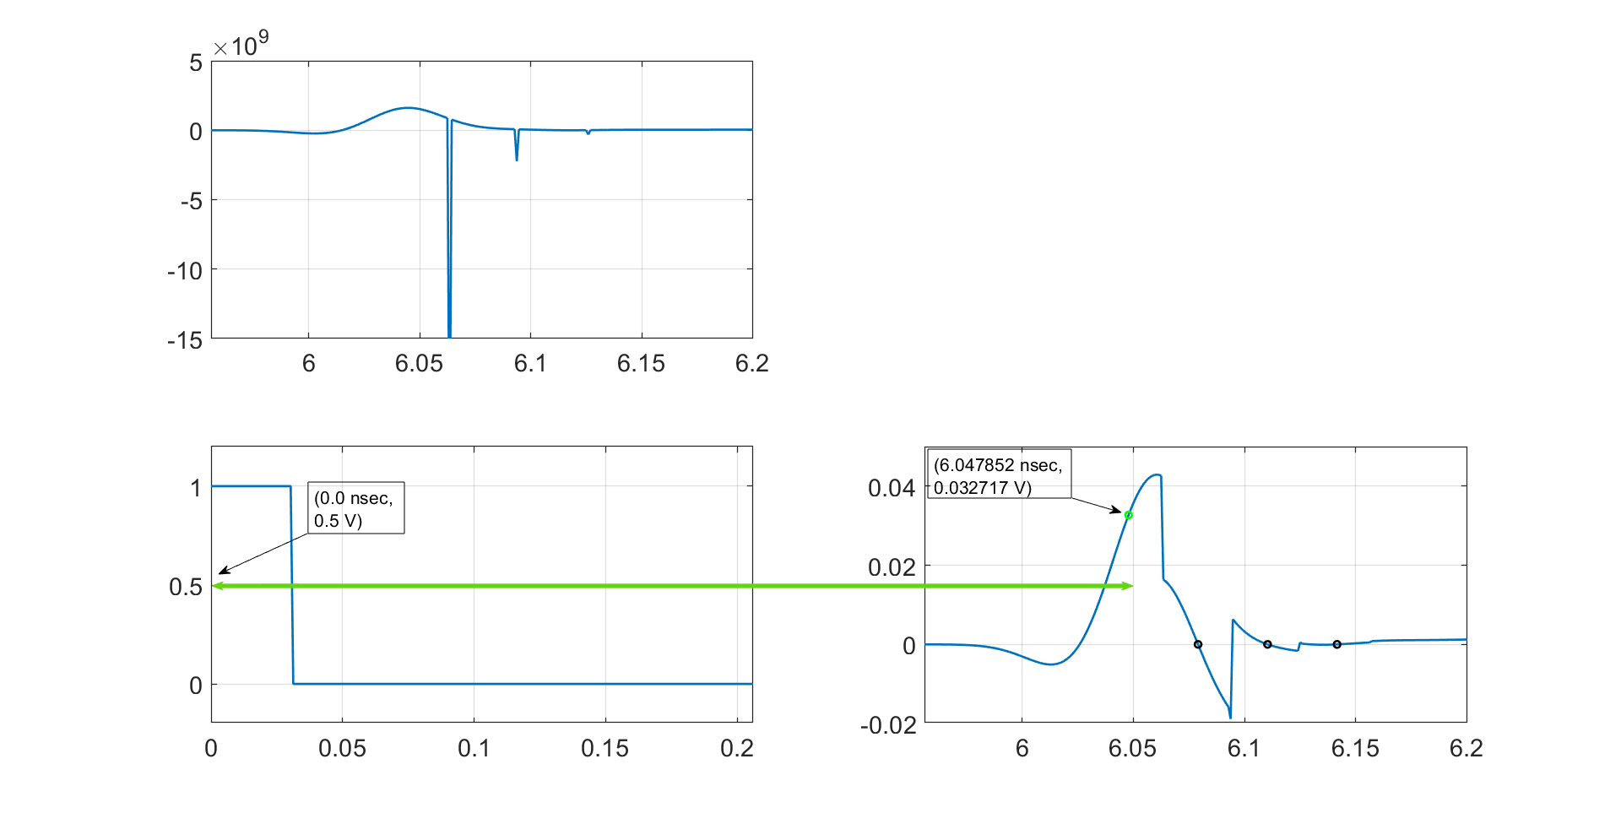
long AMI_Init (double *impulse_matrix,
long number_of_rows,
long aggressors,
double sample_interval,
double bit_time,
char *AMI_parameters_in,
char **AMI_parameters_out,
void **AMI_memory_handle,
char **msg)
(output
  (Decision_Delay_Time (Usage Out) (Value 0.0) (Type Float) (Description "Delay in decision time from the channel stimulus in unit of seconds"))
)
RX IBIS-AMI
CTLE, FFE and DFE
&
EDA tool
1.
2.
“Earlier draft”
impulse_matrix= [18238x1] double
number_of_rows= 1
agressors= 0
sample_interval= 0.9765625e-12
bit_time= 31.125e-12
AMI_parameter_in= 0x0 char
AMI_parameter_out= 39x1 char
msg= 0x0 char
Impulse Response (ir) [1/s]
pr= conv(pulse_stimulus, ir)
Actual (RX IBIS-AMI),
Unknown to EDA tool
Time [nsec]
Cursor
(output (Decision_Delay_Time 6.0478516e-09))
Post cursor
3.
4.
Pulse Stimulus [V]
Pulse Response (pr) [V]
Time [nsec]
Time [nsec]
Note: For convenience presented is a pulse response. The cursor position remains the same whether a pulse or step response.

Slide 20
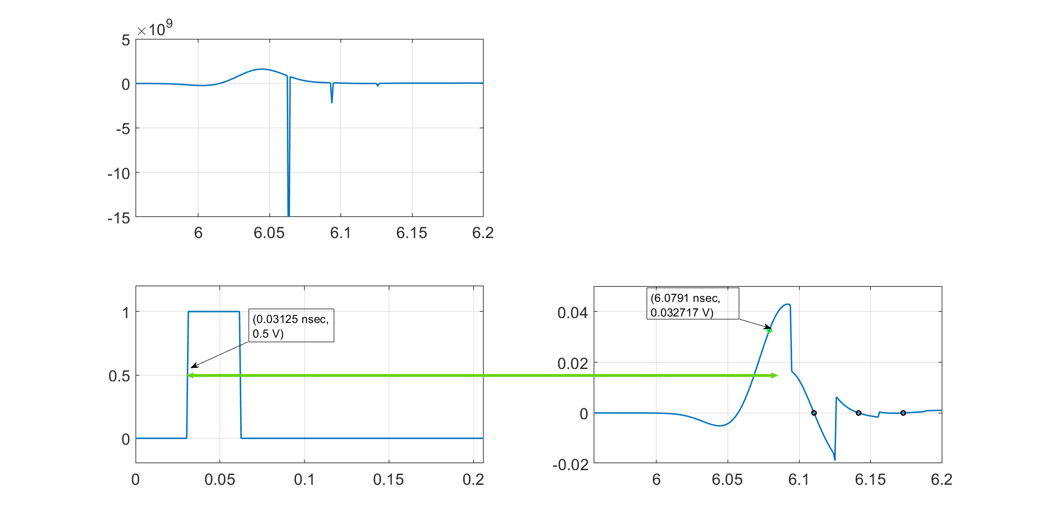
long AMI_Init (double *impulse_matrix,
long number_of_rows,
long aggressors,
double sample_interval,
double bit_time,
char *AMI_parameters_in,
char **AMI_parameters_out,
void **AMI_memory_handle,
char **msg)
(output
  (Decision_Delay_Time (Usage Out) (Value 0.0) (Type Float) (Description "Delay in decision time from the channel stimulus in unit of seconds"))
)
RX IBIS-AMI
CTLE, FFE and DFE
&
EDA tool
1.
2.
“Earlier draft”
impulse_matrix= [18238x1] double
number_of_rows= 1
agressors= 0
sample_interval= 0.9765625e-12
bit_time= 31.125e-12
AMI_parameter_in= 0x0 char
AMI_parameter_out= 39x1 char
msg= 0x0 char
Impulse Response (ir) [1/s]
pr= conv(pulse_stimulus, ir)
Actual (RX IBIS-AMI),
Unknown to EDA tool
Time [nsec]
Cursor
(output (Decision_Delay_Time 6.0478516e-09))
Post cursor
3.
4.
Pulse Stimulus [V]
Pulse Response (pr) [V]
Time [nsec]
Time [nsec]
Note: For convenience presented is a pulse response. The cursor position remains the same whether a pulse or step response.

Slide 21
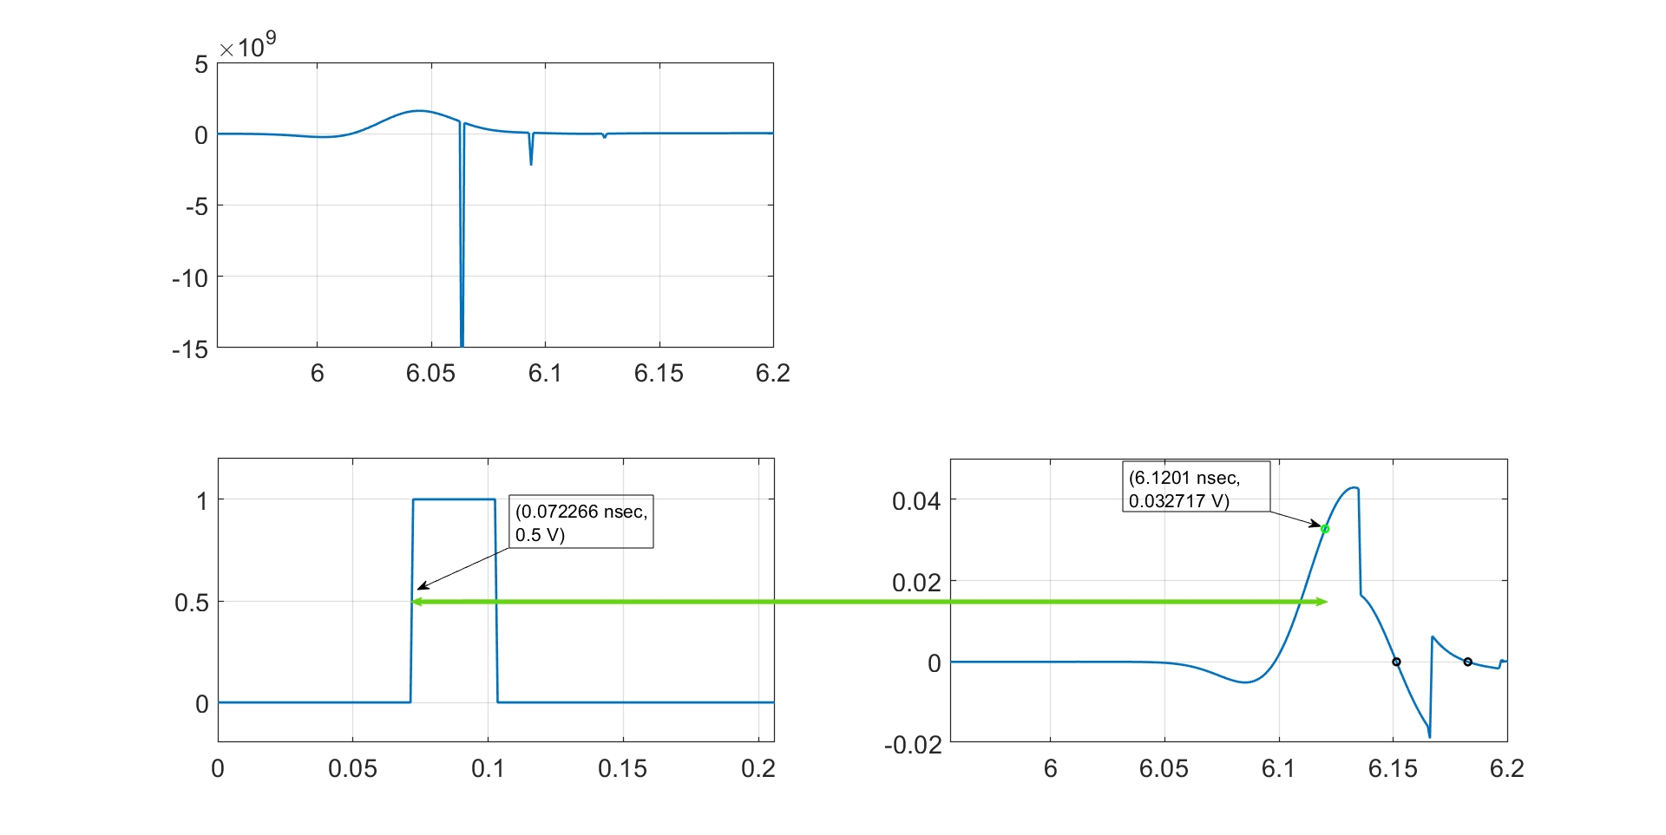
long AMI_Init (double *impulse_matrix,
long number_of_rows,
long aggressors,
double sample_interval,
double bit_time,
char *AMI_parameters_in,
char **AMI_parameters_out,
void **AMI_memory_handle,
char **msg)
(output
  (Decision_Delay_Time (Usage Out) (Value 0.0) (Type Float) (Description "Delay in decision time from the channel stimulus in unit of seconds"))
)
RX IBIS-AMI
CTLE, FFE and DFE
&
EDA tool
1.
2.
“Earlier draft”
impulse_matrix= [18238x1] double
number_of_rows= 1
agressors= 0
sample_interval= 0.9765625e-12
bit_time= 31.125e-12
AMI_parameter_in= 0x0 char
AMI_parameter_out= 39x1 char
msg= 0x0 char
Impulse Response (ir) [1/s]
pr= conv(pulse_stimulus, ir)
Actual (RX IBIS-AMI),
Unknown to EDA tool
Time [nsec]
Cursor
(output (Decision_Delay_Time 6.0478516e-09))
Post cursor
3.
4.
Pulse Stimulus [V]
Pulse Response (pr) [V]
Time [nsec]
Time [nsec]
Note: For convenience presented is a pulse response. The cursor position remains the same whether a pulse or step response.

